Slide 1

Forest monitoring system
TEAM SUPER BATS
TEAM MEMBERS: APOORVA MATHAD
KEERTI. A
REKHA .K

Slide 2
CONTENTS
Create a drone
Activity of the drone
What benefit our drone will provide
Delivery mechanism

Slide 3

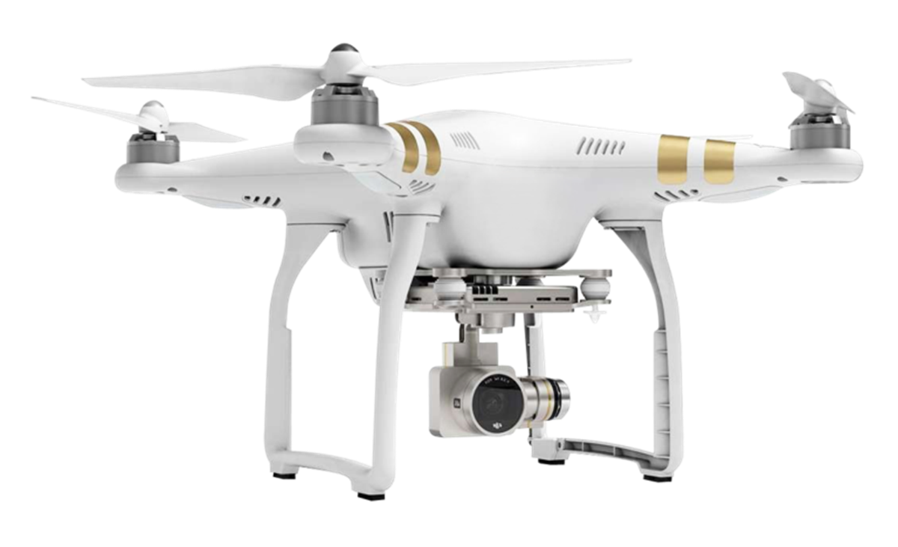
Super Bat DA-50. Powered by batteries, its flight time ranges from eight to ten hours

Slide 4
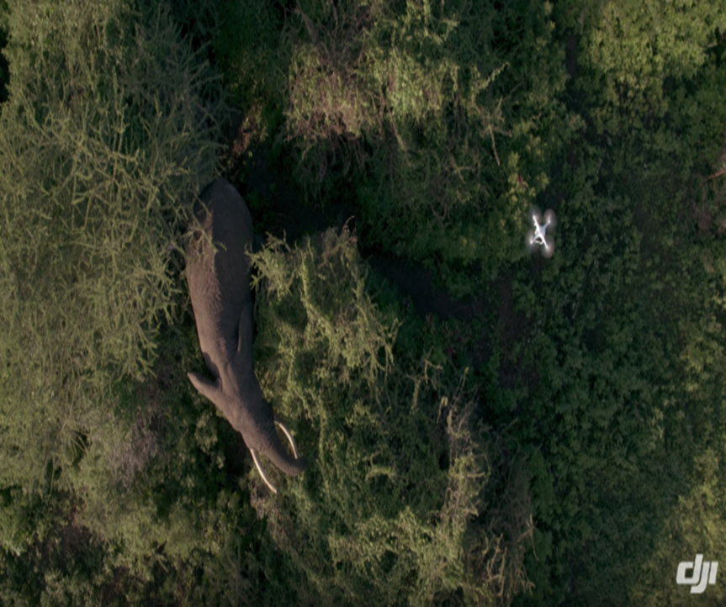
How our drone used in animal monitoring
Animal tracking, capturing the best shots of wildlife, population counts, reforestation planning, illegal operations, and other duties may all be done with UAVs.
By monitoring biodiversity protection, encroachments, forest health, forest fires, poaching, tree-felling, mangrove conservation, and the quality of water sources.
UAV based solutions from leading cloud service providers for wildlife help to build a better tomorrow.
https://www.youtube.com/watch?v=4Ub0W9PL35w

Slide 5
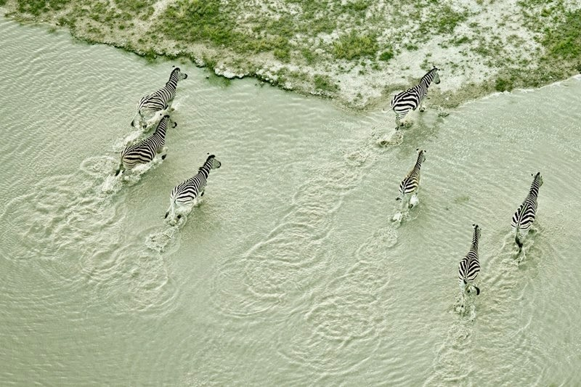
ACTIVITY OF DRONE
The advanced features like altimeters, cameras, and GPS tracking present in UAV based solutions have become a driving force for wildlife monitoring.
The UAV based solutions have long-distance focus point cameras for round-the-clock monitoring of animals.
Data engineering consulting firms provide integrated accelerators and motion sensors for UAV drones that collect accurate data on animals and birds movement.

Slide 6
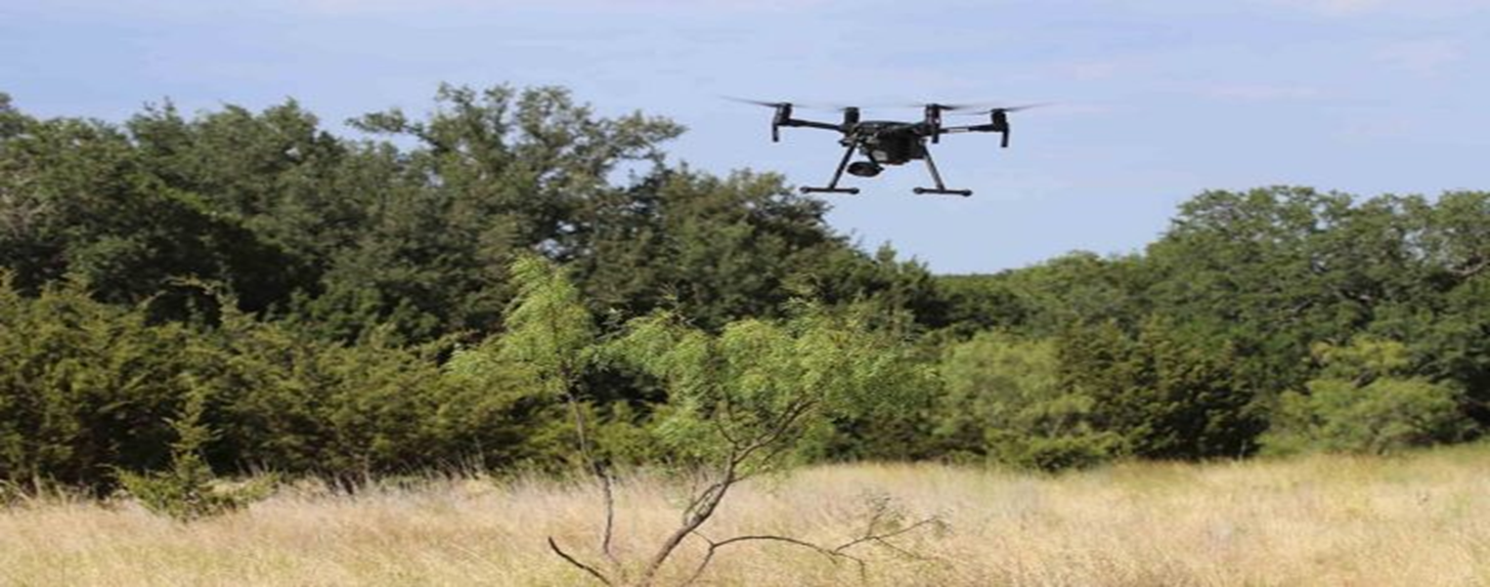
benefits our drone will provide
The drones are used to count, study, and protect animals from harm.
They are far more accurate at counting species and can record vast amounts of data quicker than a person could.
And drone also alarms when a forest is caught with fire, and quicker action could be taken.
A drone in the air can closely track migration movements, monitor the health of animals, and even identify different animal species. Drones are even being used to track poachers to aid in the prevention of illegal slaughter.

Slide 7
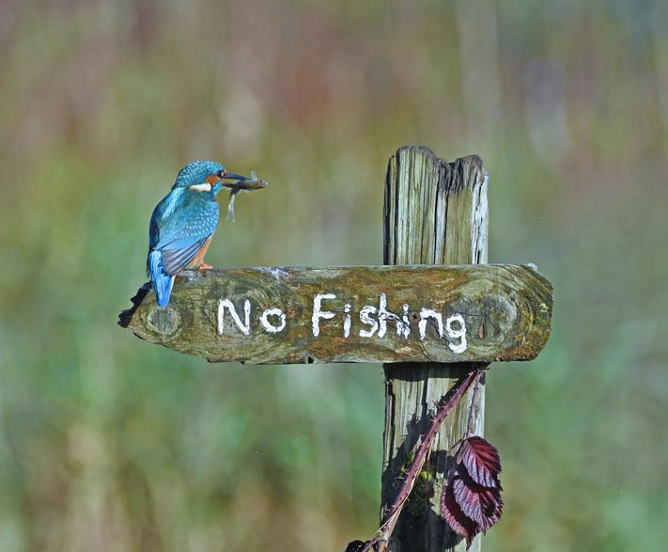
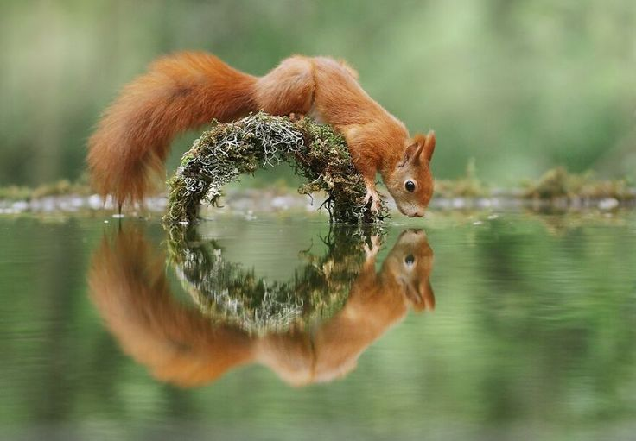
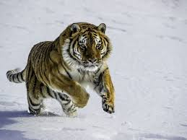
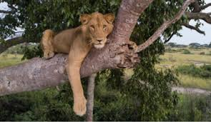
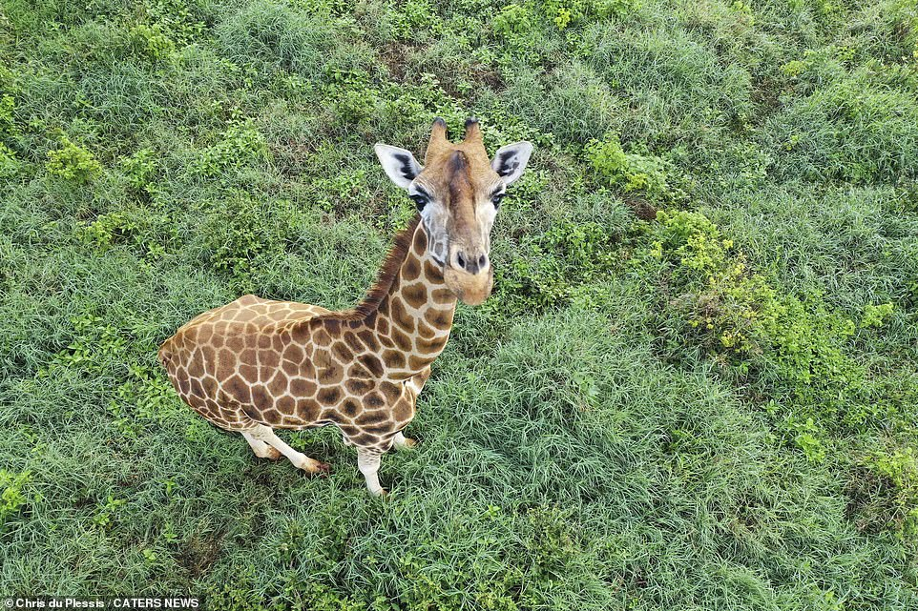
DON’T SHOOT US WITH GUNS, SHOOT US WITH CAMERAS.

Slide 8
DELIVERY MECHANISM
A Digital image of an animal footprint is captured using a standard camera.
The image is run through Wild Track’s FIT(Flexible Innovative Targeted software)
The software extracts key data (distances, angles and areas) from the footprint to characterize the individual that made it and even it can even determine, with a high degree of accuracy, which species, individual, age-class left that print.
Drones provide easy access to aerial data, which is used by firefighters to identify hotspots and map the spread of the fire
Thermal sensors measure heat and are used to detect fire hotspots. Infrared sensors are also used to detect emissions.
PIR sensors are used to detect animals.

Slide 9
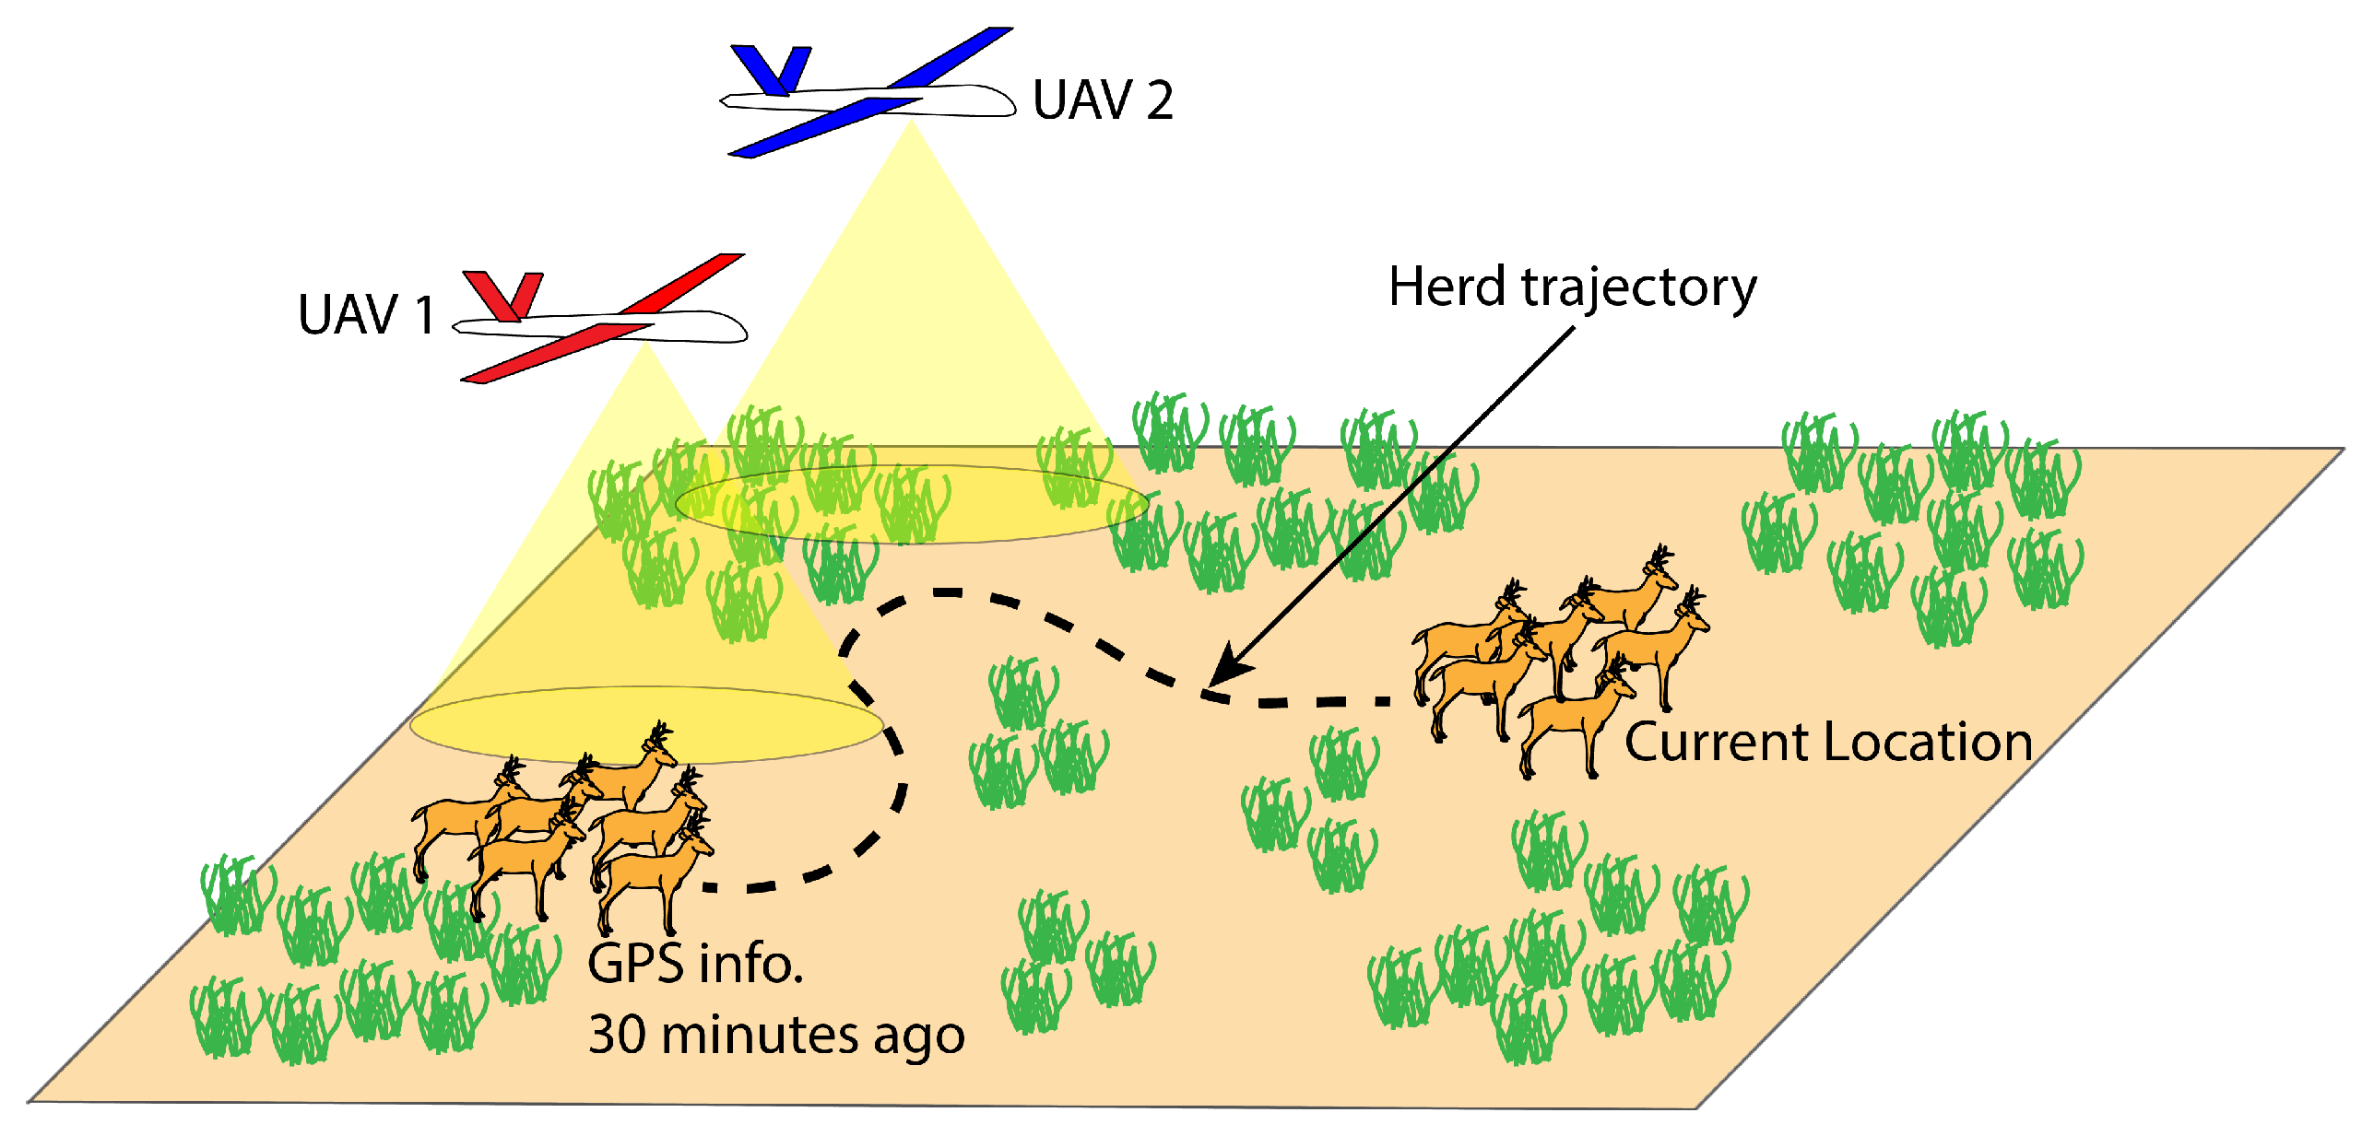
dIAGRAmATIC REPRESENTATION OF MECHANISM OF DRONE

Slide 10
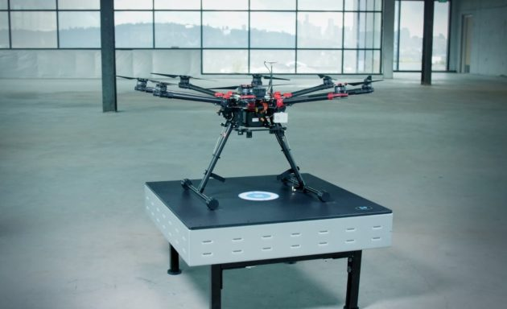
Charging challenges of drone
Powermat’s uses electromagnetic induction to transfer energy between a transmitter (Power mat Charging Spot) and receiver
Powermat's wireless charging for drones provides an ultra-lightweight design that supports up to 600W of charging power. The system allows high misalignment between the receiver and transmitter, up to 200mm, and comes with integrated guided landing features.
During the charging the status LED will blink green slowly. When the status LED indicator is solid green all the batteries are fully charged.

Slide 11
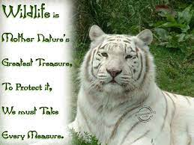
THANK YOU

